Slide 1
SMART POLITICS 101
Essential Tools for Persuasive Conversations
March 13, 2024

Slide 2
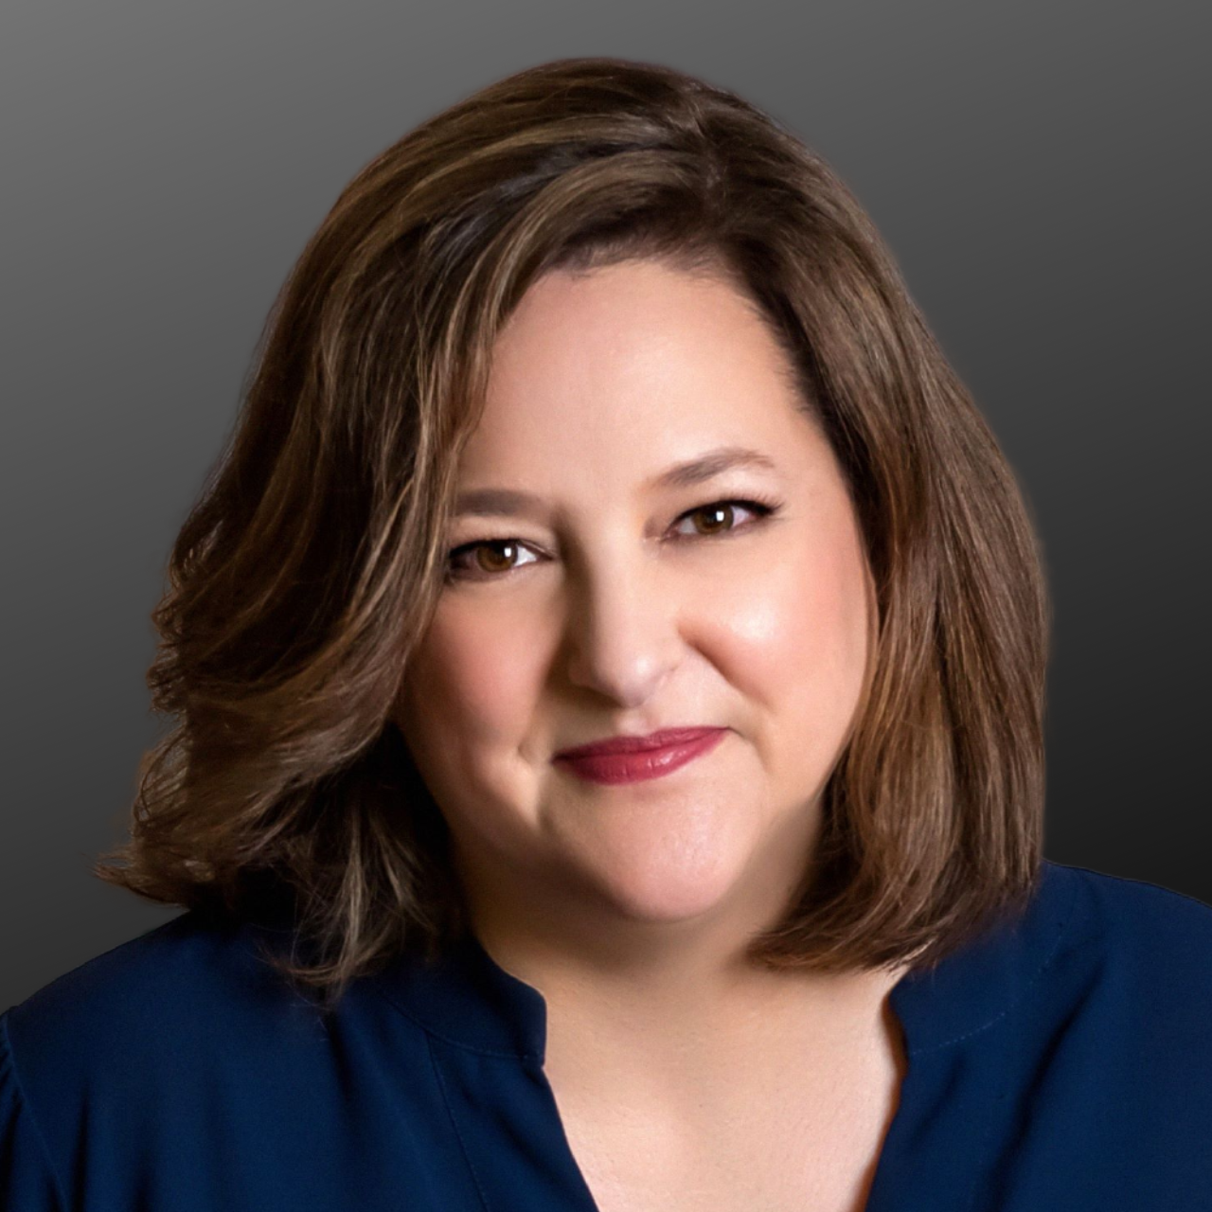
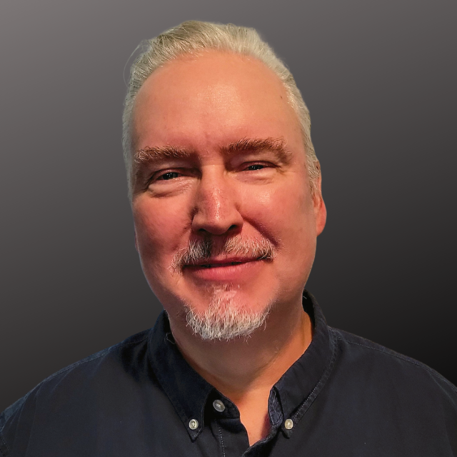
Presented by
Karin Tamerius, MD
Founder, Smart Politics
Political Psychiatrist
Locke Peterseim
Content Manager

Slide 3
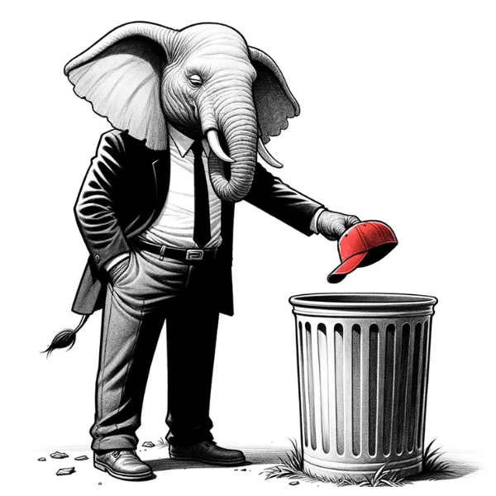
AGENDA
Why is political persuasion so hard?
How does persuasion work?
What’s the secret to persuading Republicans?
How can you get started?
Q & A
BONUS: AI Angry Uncle Bot
Notes:
Demo
Q&A
After-party!!!

Slide 4
Why is it so hard to persuade Republicans?

Slide 5
People value their autonomy.
When we try to change them, they resist to maintain their independence.
Paradox of Persuasion

Slide 6
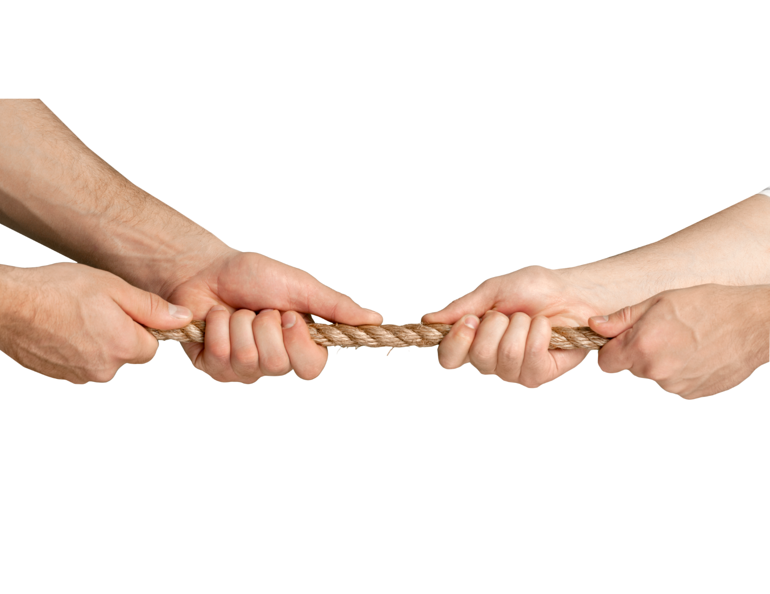
Reactance
Psychological aversion to being controlled by others
Causes people to take action to show their autonomy
It’s why two year-olds say “no”

Slide 7
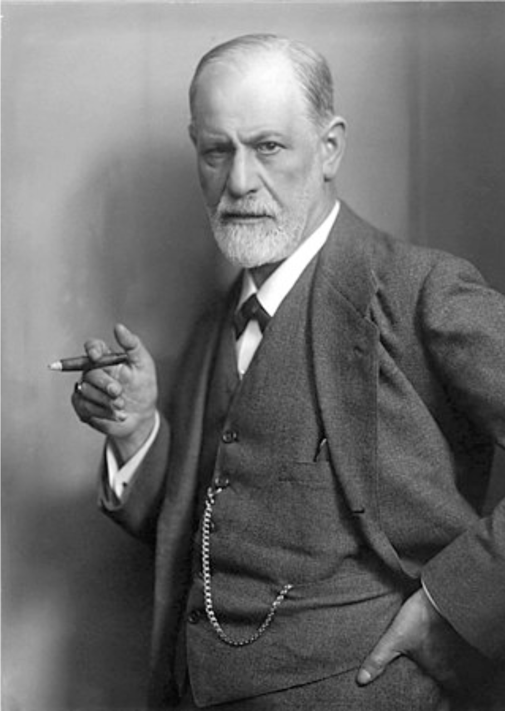
Ego Defenses
Safeguards to protect us from having bad thoughts/feelings
Protects self-esteem and maintains emotional stability
Includes denial, projection, rationalization, intellectualization

Slide 8
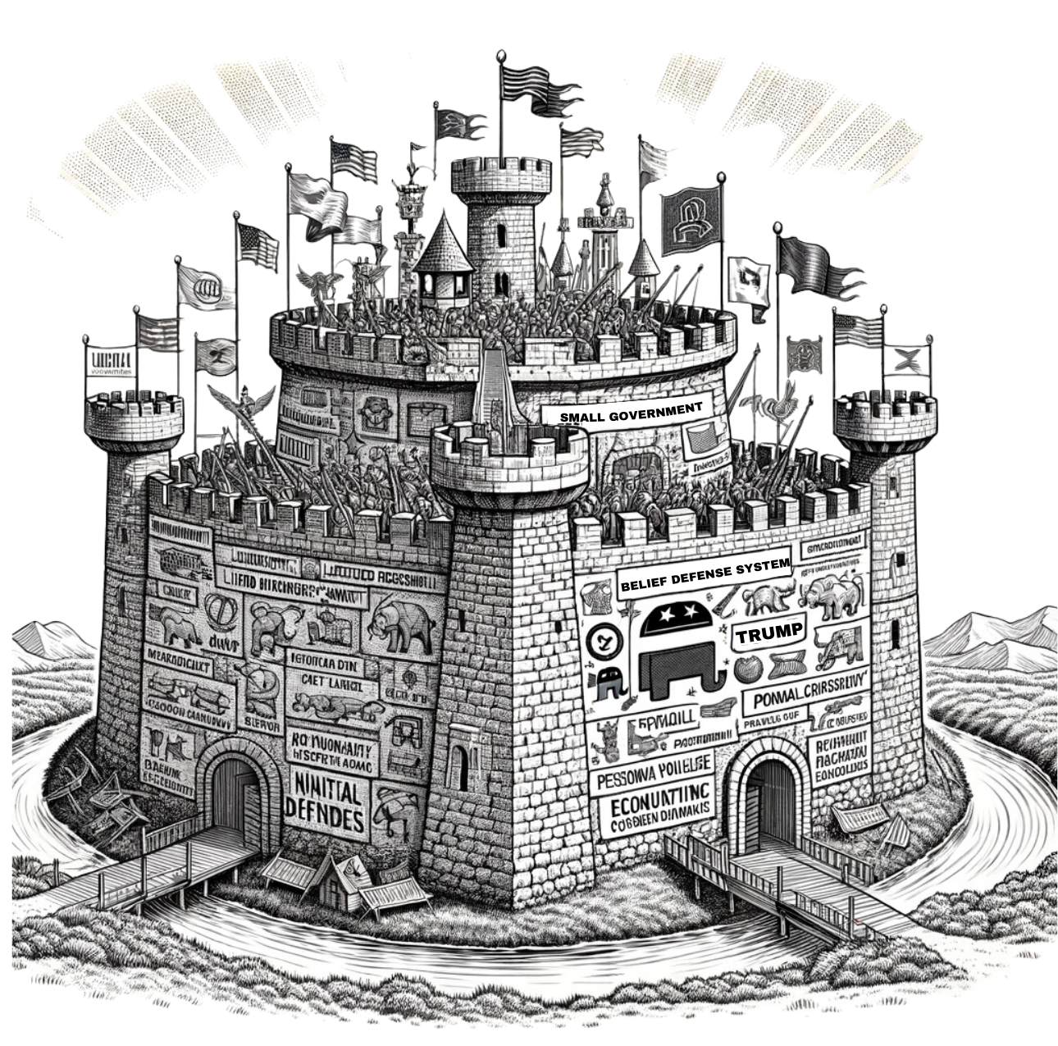
Belief System Defenses
Safeguards to maintain a stable worldview
Confirmation bias
Rationalization
Dismissive of alternative evidence and arguments

Slide 9
Three Things That Don’t Work
Telling people what to do
Making people feel bad about themselves
Attacking their view of the world with facts and reasoned arguments

Slide 10
How does persuasion work?

Slide 11
Dual Process Model
The brain processes persuasive messages in two ways:
Fast, intuitive, gut-level assessments
Slow, reasoned, effortful analysis
Intuition is more important than reason

Slide 12
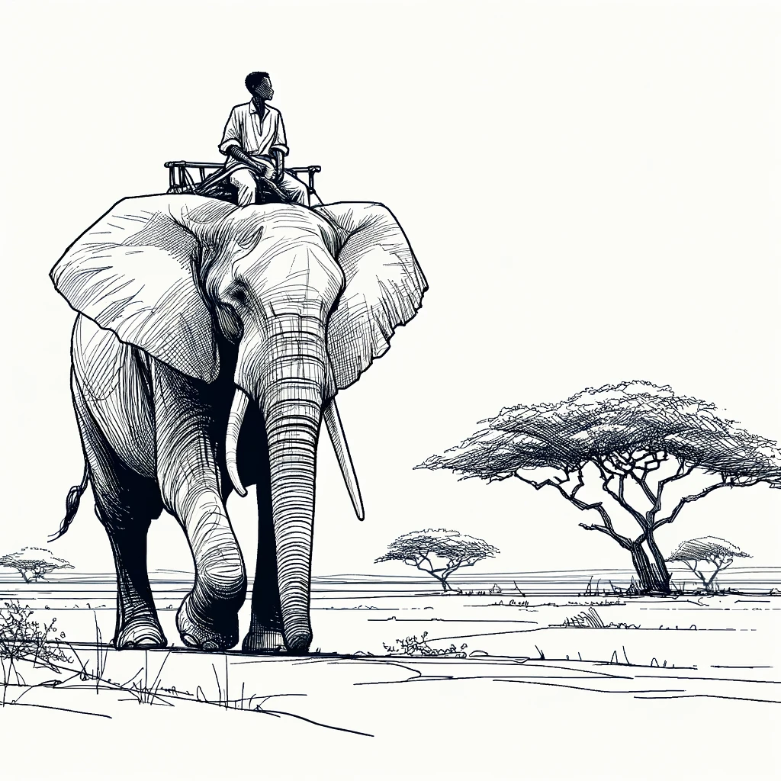
Haidt’s Metaphor of Rider on an Elephant
The elephant is persuaded by gut feelings
The rider is persuaded by facts and reason

Slide 13
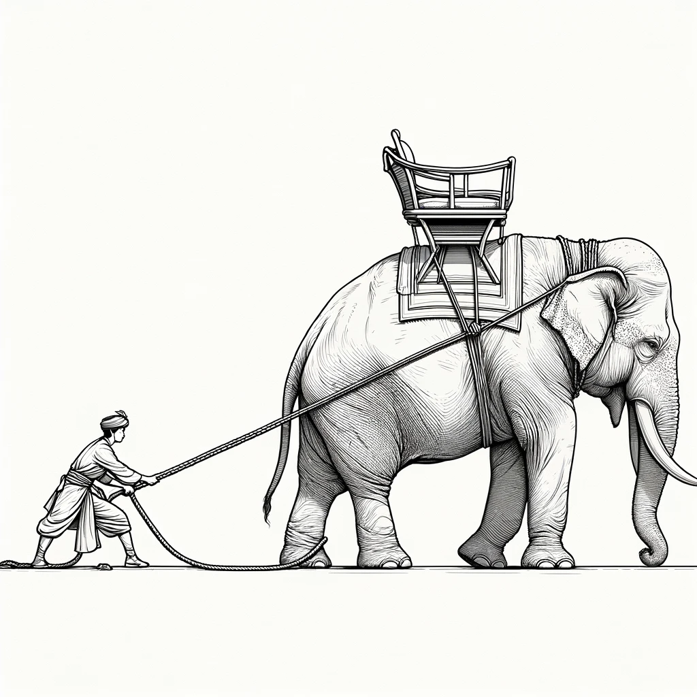
Haidt’s Metaphor of Rider on an Elephant
If the elephant doesn’t want to go somewhere, the rider can’t force it
So, while the reasonable rider seems in charge, the emotional elephant has all the power

Slide 14
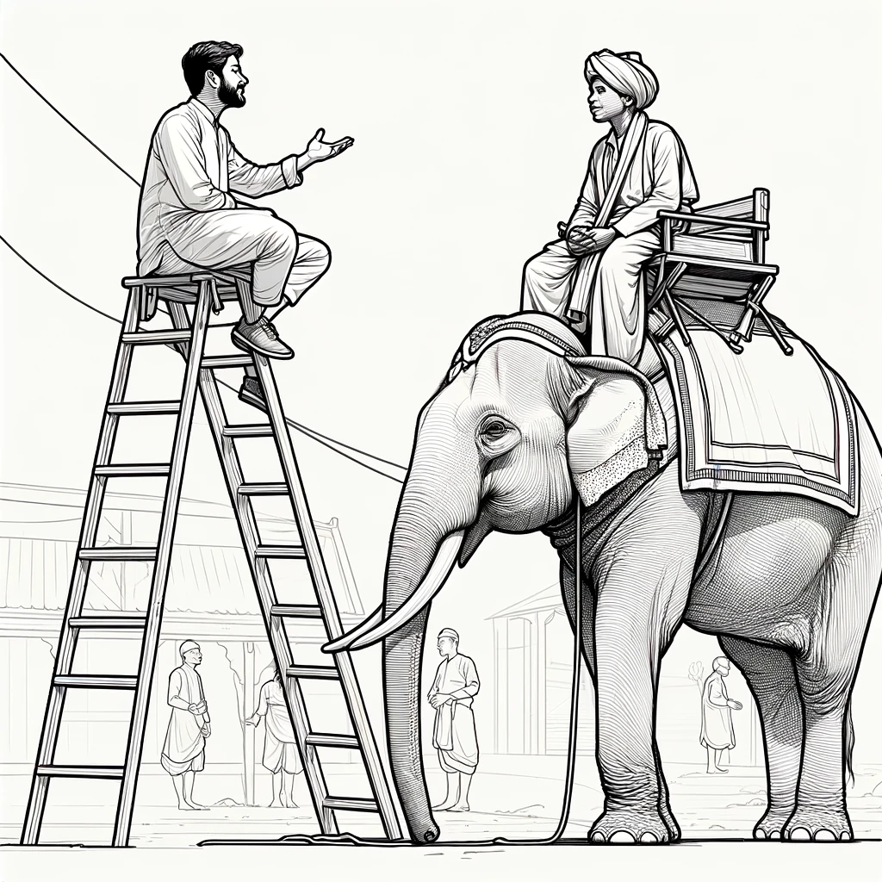
Haidt’s Metaphor of Rider on an Elephant
So what’s the problem?
Successful influence is mostly about persuading elephants
But we squador our time and energy trying to persuade riders

Slide 15
What’s the secret to persuading Republicans?

Slide 16
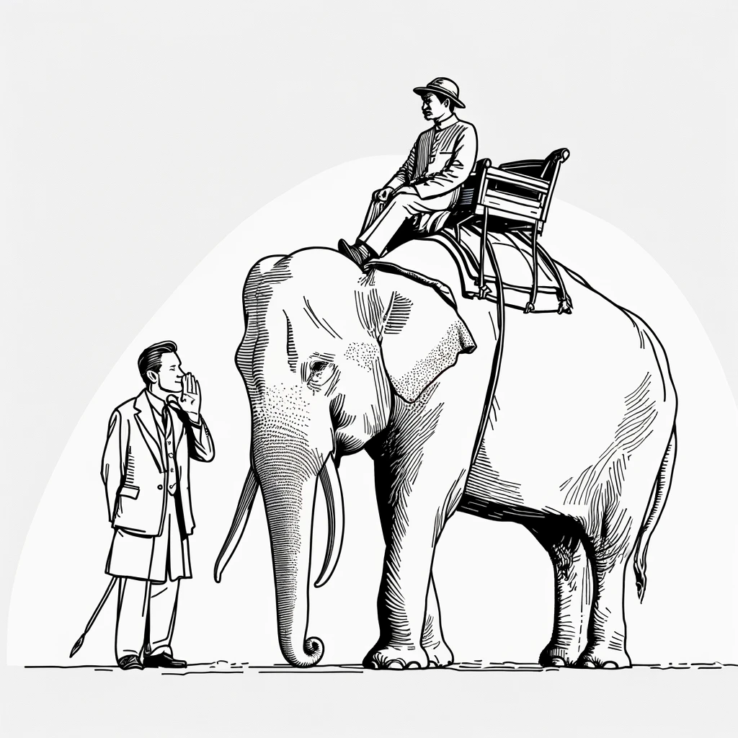
Stop talking with riders.
Communicate with elephants!

Slide 17
Key characteristics of elephants
Skittish
Emotional
Social
Uninterested in facts and reason
Respond more to behavior and tone than words
Set in their ways
Wary of novelty

Slide 18
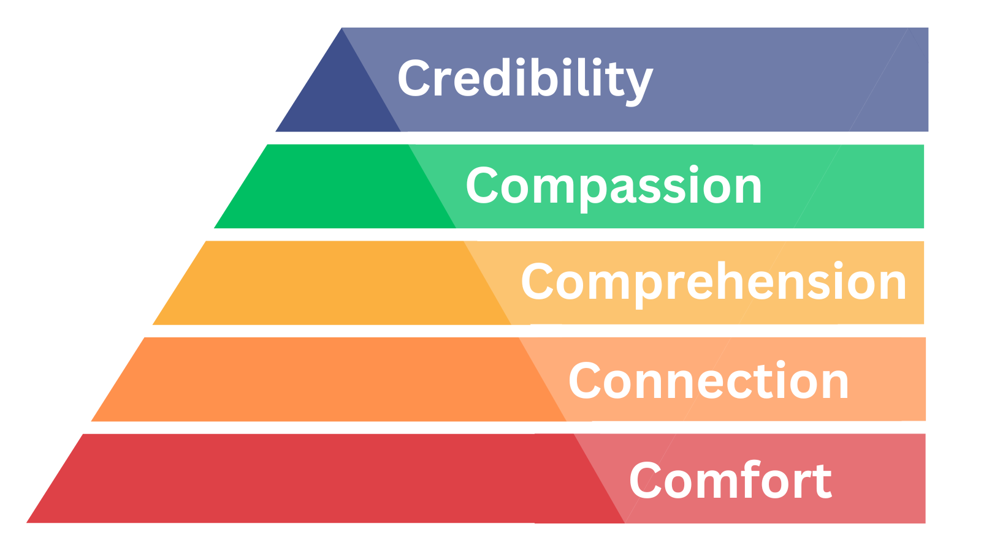
What’s the secret to persuading elephants?
Earn their trust.
Trust Pyramid
r

Slide 19
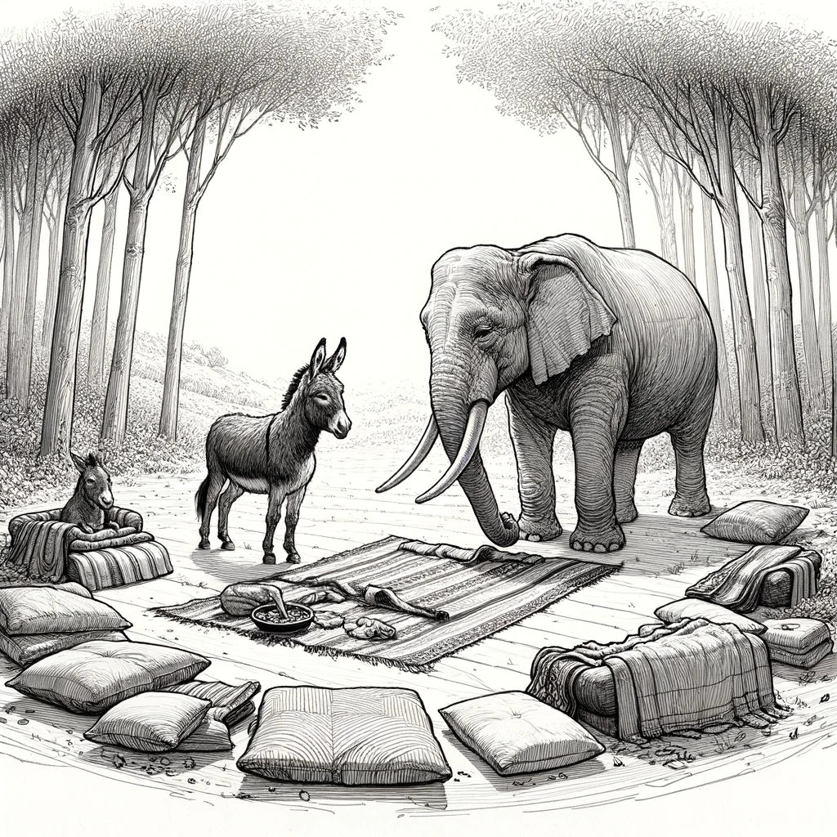
Make them feel safe-enough to talk with you
Comfort
Notes:
Dunbar’s number. Relational organizing is about leveraging these relationships to win elections

Slide 20
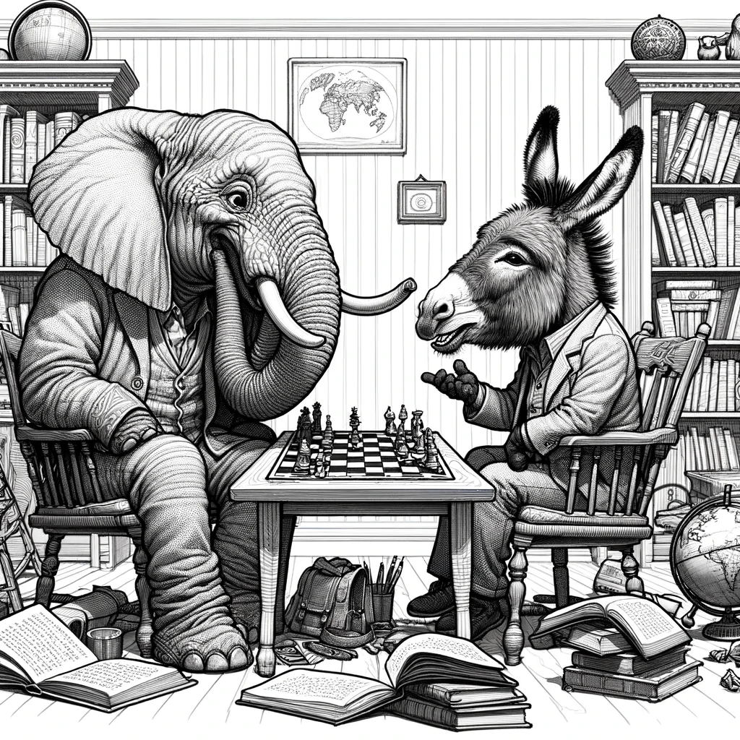
Connection
Find ways you are alike and come to like one another as people.
Notes:
Dunbar’s number. Relational organizing is about leveraging these relationships to win elections

Slide 21
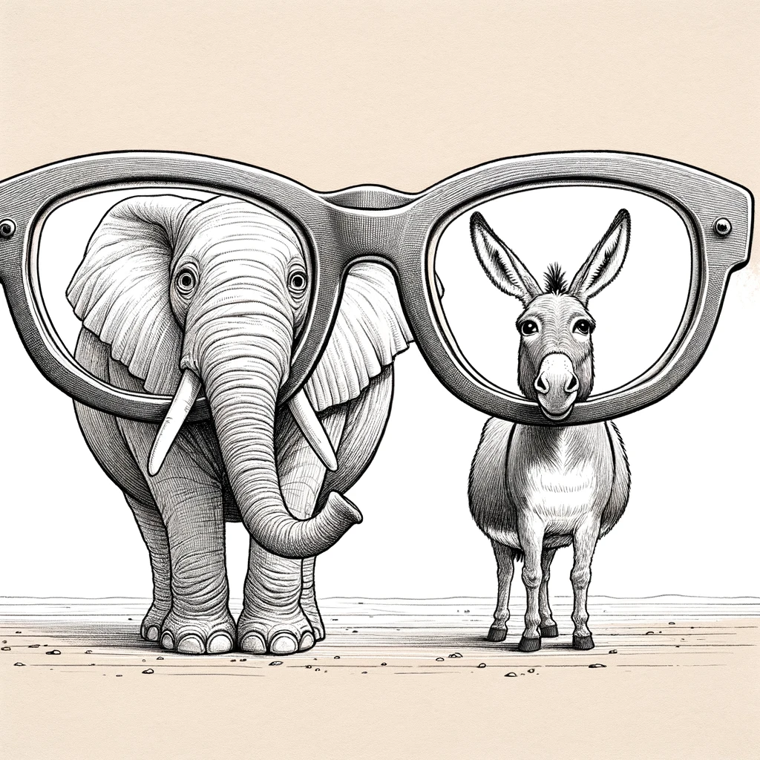
Comprehension
Learn their point of view and be able to see the world from their perspective.
Notes:
Dunbar’s number. Relational organizing is about leveraging these relationships to win elections

Slide 22
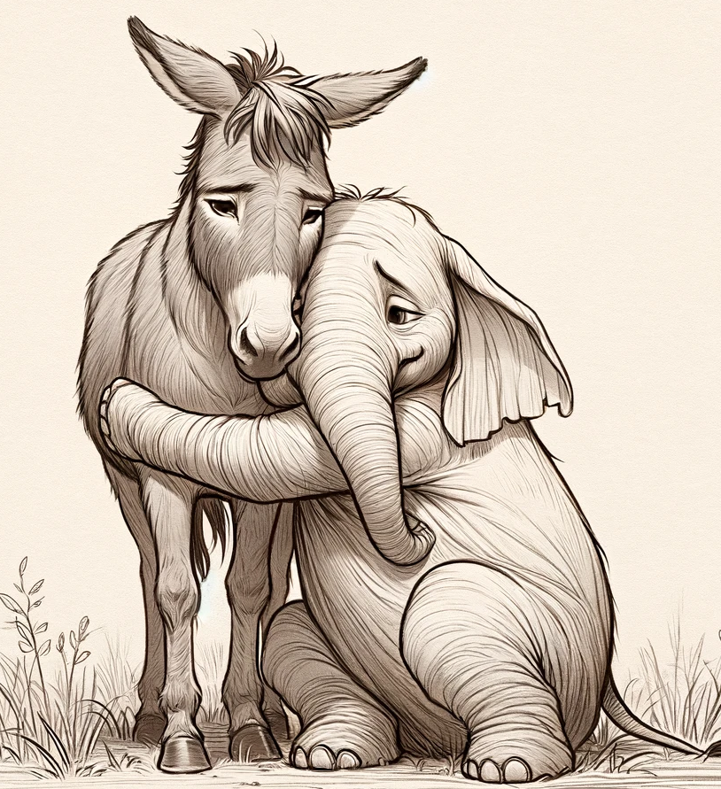
Compassion
Show you care about them and don’t want them to suffer.
Notes:
Dunbar’s number. Relational organizing is about leveraging these relationships to win elections

Slide 23
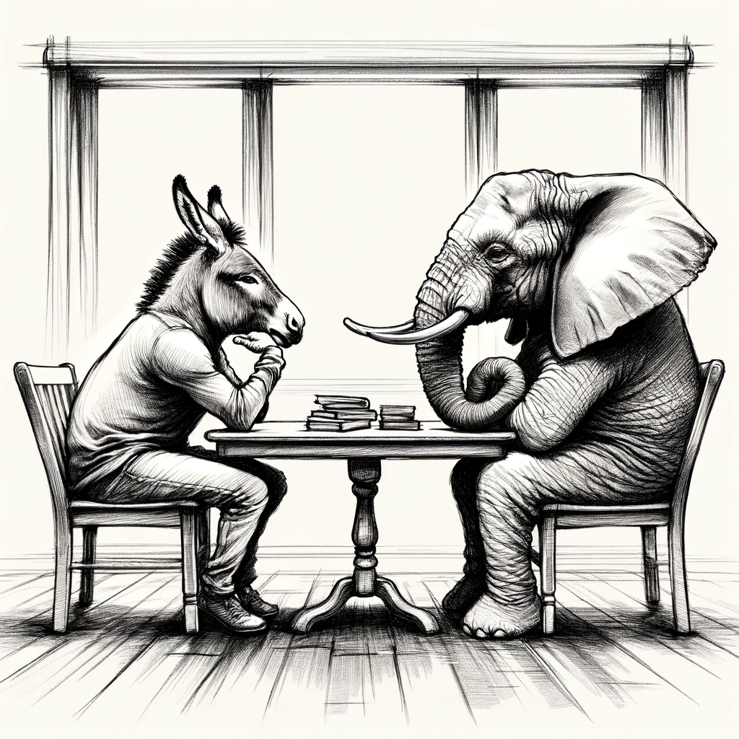
Credibility
Show you are doing your best to be rational, unbiased, and open-minded.
Notes:
Dunbar’s number. Relational organizing is about leveraging these relationships to win elections

Slide 24
What happens when you earn
the elephant’s trust?

Slide 25
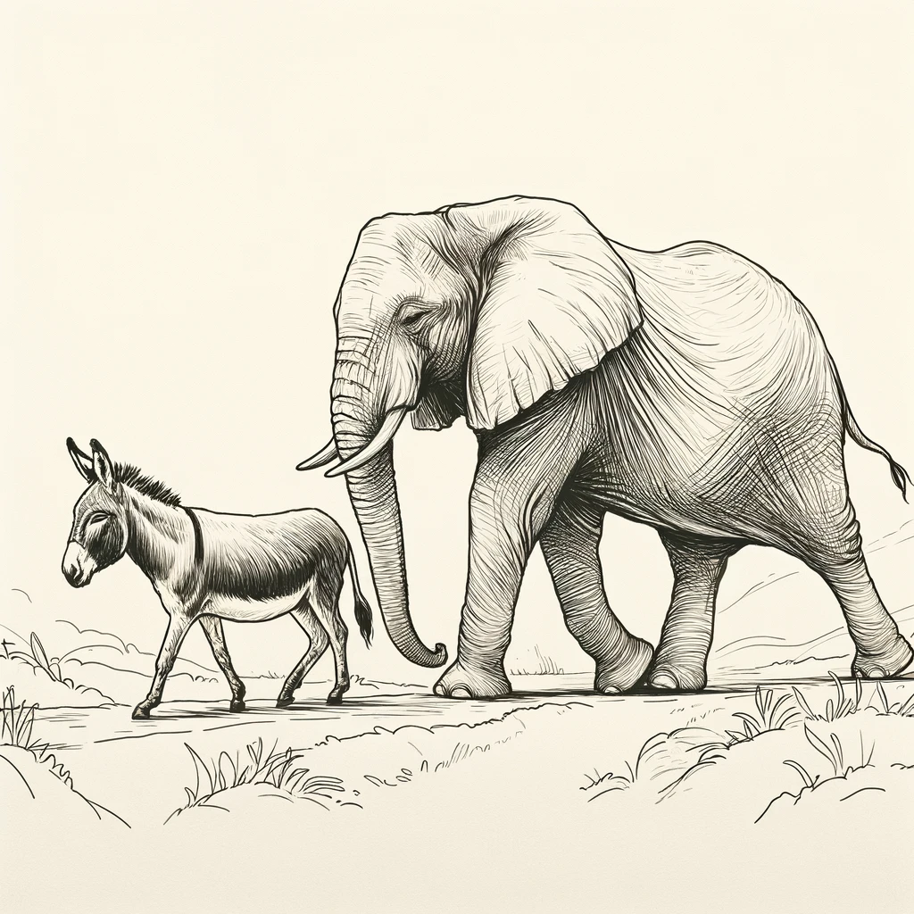
The elephant WANTS to follow you!
r

Slide 26
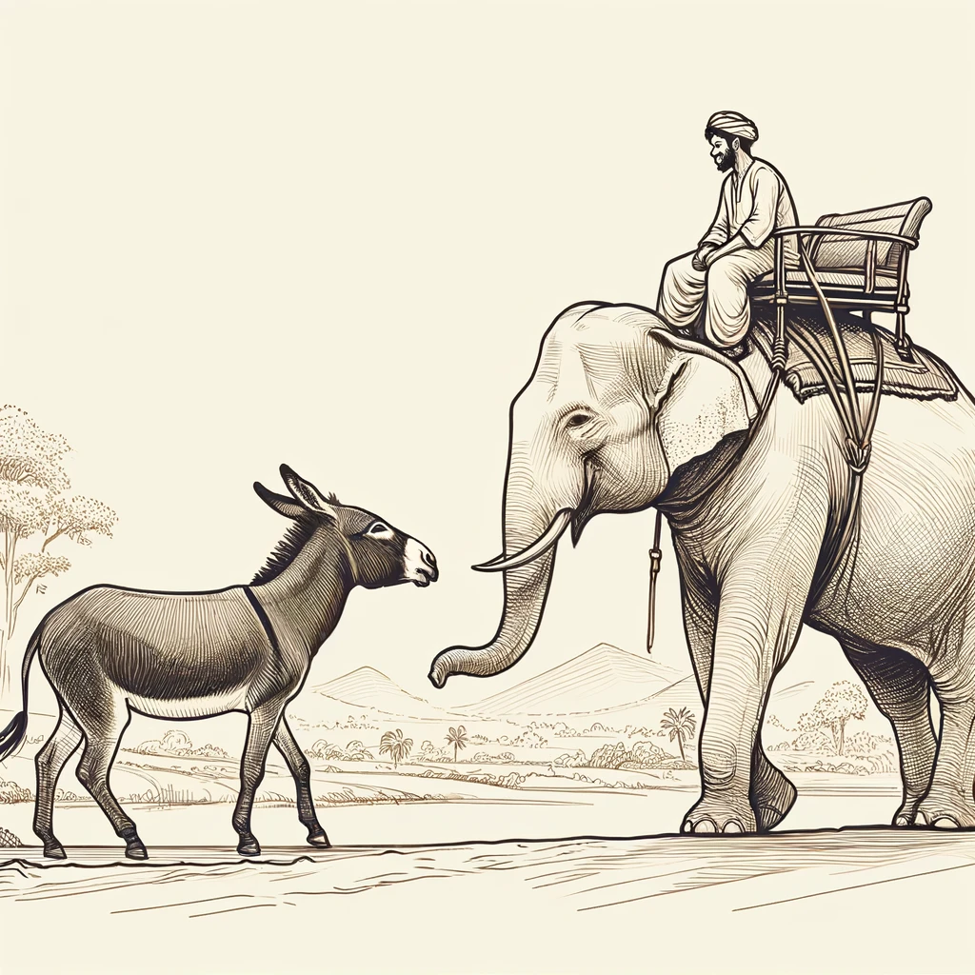
NOW you can talk with the rider

Slide 27
How can you get started?

Slide 28
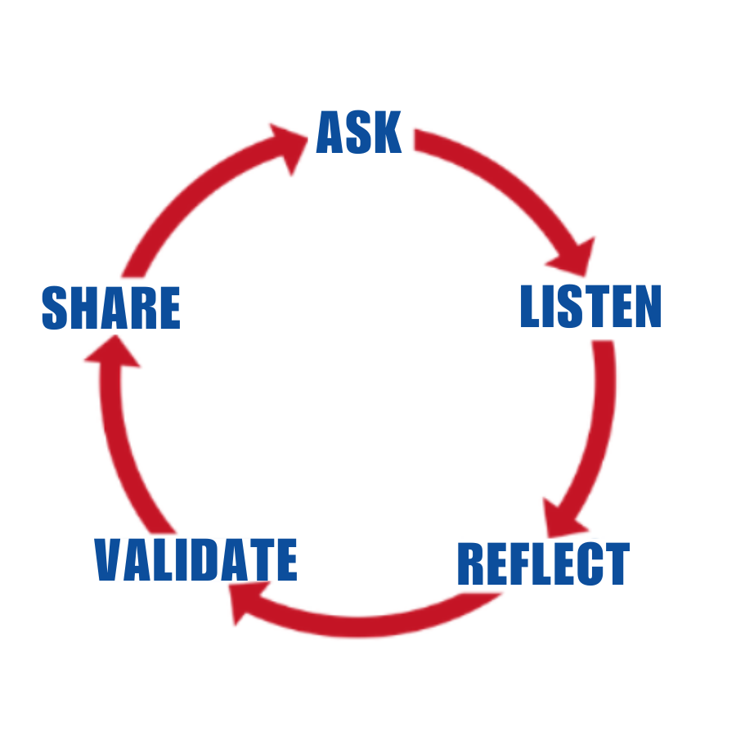
Persuasion
Conversation
Cycle

Slide 29
Ask
Open-ended
Nonjudgmental
Curious

Slide 30
Listen
Pay attention
Seek to understand
Don’t interrupt
Let them talk as long as they want

Slide 31
Reflect
Summarize
Name feelings
Acknowledge implicit content

Slide 32
Validate
Acknowledge the legitimacy of their beliefs and feelings
Accept their experience
Agree where possible
Describe a time when you felt the same

Slide 33
Share
Don’t argue with facts or reason
Shift the narrative with a personal story or anecdote
Share information only after getting consent

Slide 34
Demo

Slide 35
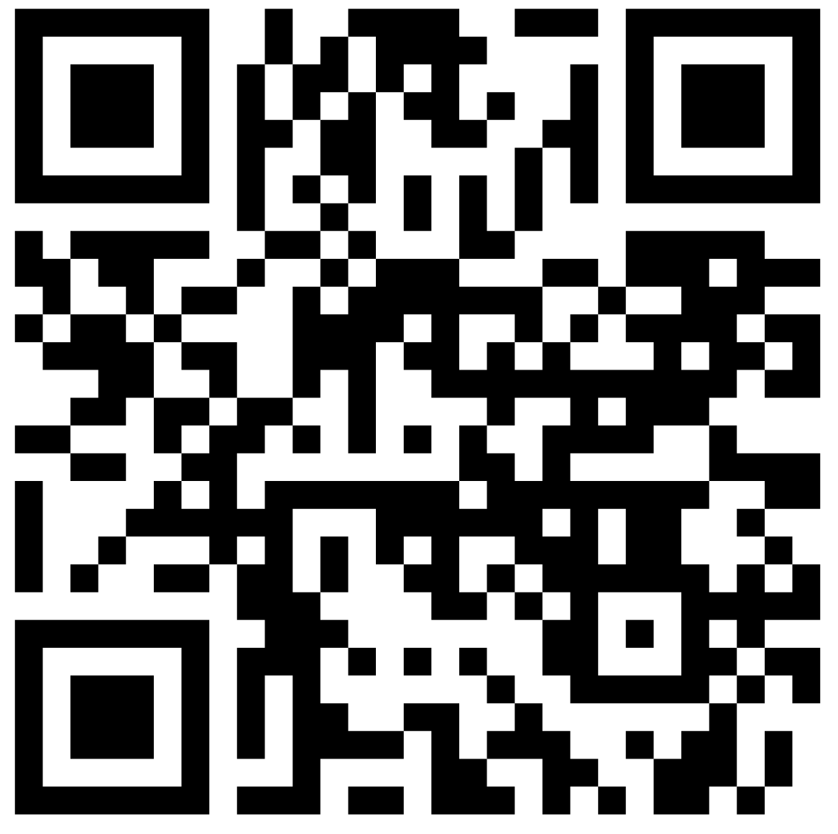
Before you go…
Put your new skills
to work!
Linktr.ee/itsnottoolateproject

Slide 36
Tell your friends!
If you liked this webinar, they will too!

Slide 37
Thank you!
JoinSmart.org

Slide 38
After Party!!!

Slide 39
How can this work at scale?

Slide 40
“Just as ripples spread out when a single pebble is dropped into water, the actions of individuals can have far-reaching effects.”
--Dalai Lama--

Slide 41
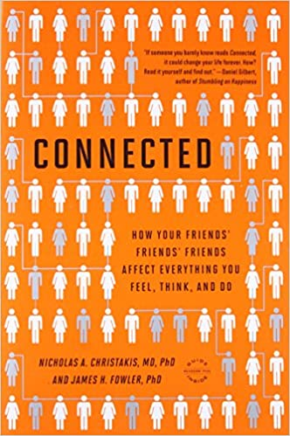
Three Degrees of Influence Rule
“Everything we do or say tends to ripple through our network, having an impact on our friends (one degree), our friends’ friends (two degrees), and even our friends’ friends’ friends (three degrees).”
Political
Notes:
Any guesses as to how many people that means you impact on average with every action?

Slide 42
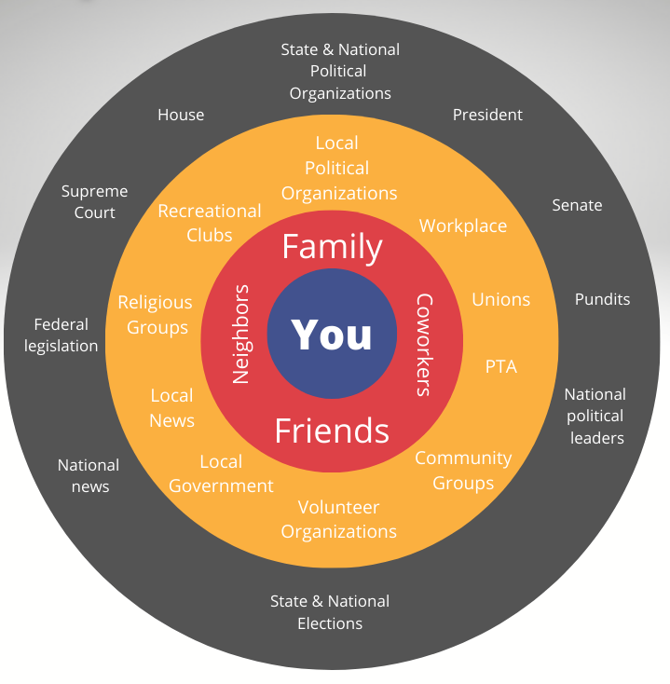
Levels of Political
Influence
Notes:
Breakout group exercise:
Think of a time someone close to you influenced your political thinking or behavior
Think of a time you influenced the political thinking or behavior of someone close to you

Slide 43
Discussing politics with people in our personal sphere of influence is
the most effective way for us to make a difference.
Political
Notes:
And it will improve our relationships too!

